Slide 1
It’s Not a phase Mom!
An analysis of Kansas City, Missouri Crime Data and the occurrence of Full Moons
By: Ashley Desai, Darcey Altschwager and Matt CoPple

Slide 2
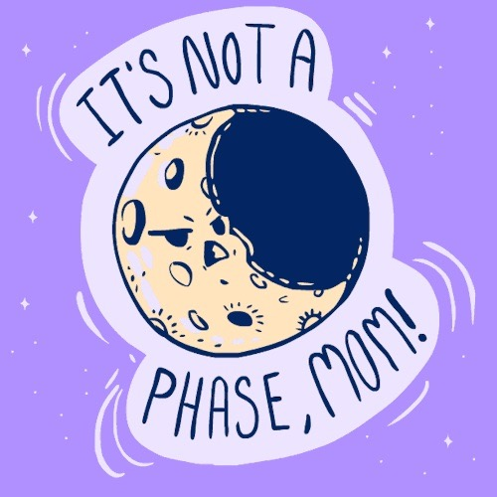
Background
Whether or not you give into the phenomenon, many people believe that the moon can effect one’s behavior depending on what phase the moon is in.
The defense of “My bad behavior was caused by a full moon” has been used in a few court cases
Notes:
Define the core message or hypothesis of your project.
Describe the questions you asked, and why you asked them
Describe whether you were able to answer these questions to your satisfication, and briefly summarize your findings

Slide 3
Motivation & Summary
Hypothesis:
We hypothesize that days in which there was a full moon, crime rates will be higher in Kansas City, Missouri compared to other phases of the moon
Questions Asked:
How many offenses were committed in KCMO on full moons?
Which gender commits more crimes on full moons?
Are firearms involved more during crimes committed on full moons?
Notes:
Define the core message or hypothesis of your project.
Describe the questions you asked, and why you asked them
Describe whether you were able to answer these questions to your satisfication, and briefly summarize your findings

Slide 4
Data
KCMO Crime Data
Source: Open Data KC
Data Set: All crimes reported in Kansas City Missouri during 2017
Moon Phase Data
Source: Moon Giant
Data Set: Created our own data set by pulling information on the phases of the moon and illumination for each day in 2017
Notes:
Describe the exploration and cleanup process
Discuss insights you had while exploring the data that you didn't anticipate
Discuss any problems that arose after exploring the data, and how you resolved them
Present and discuss interesting figures developed during exploration, ideally with the help of Jupyter Notebook

Slide 5
The Analysis
Notes:
Discuss the steps you took to analyze the data and answer each question you asked in your proposal
Present and discuss interesting figures developed during analysis, ideally with the help of Jupyter Notebook

Slide 6
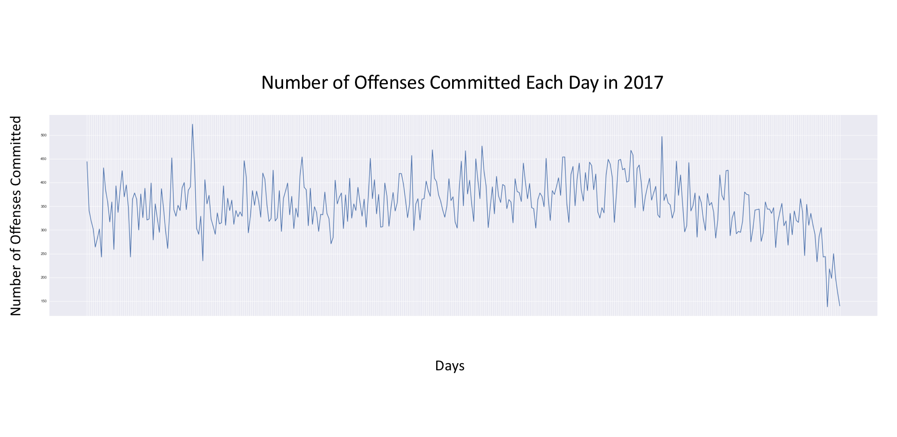
Notes:
Discuss the steps you took to analyze the data and answer each question you asked in your proposal
Present and discuss interesting figures developed during analysis, ideally with the help of Jupyter Notebook

Slide 7


Slide 8
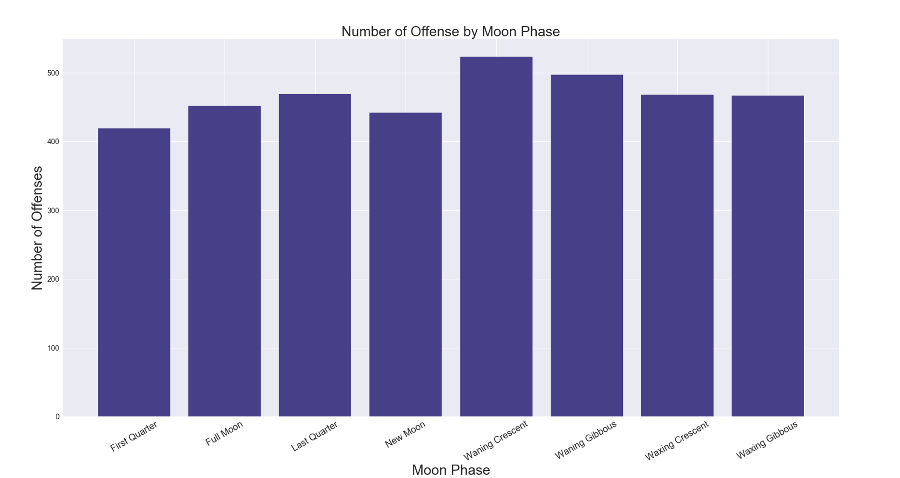
Notes:
Discuss the steps you took to analyze the data and answer each question you asked in your proposal
Present and discuss interesting figures developed during analysis, ideally with the help of Jupyter Notebook

Slide 9
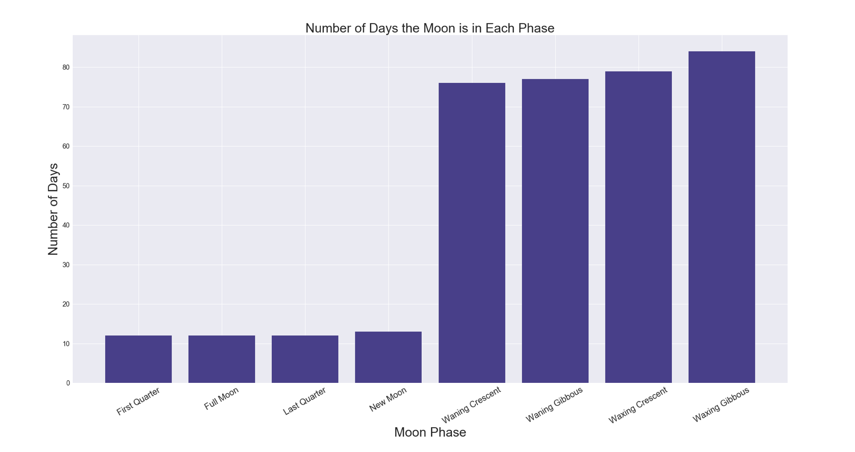
Notes:
Discuss the steps you took to analyze the data and answer each question you asked in your proposal
Present and discuss interesting figures developed during analysis, ideally with the help of Jupyter Notebook

Slide 10
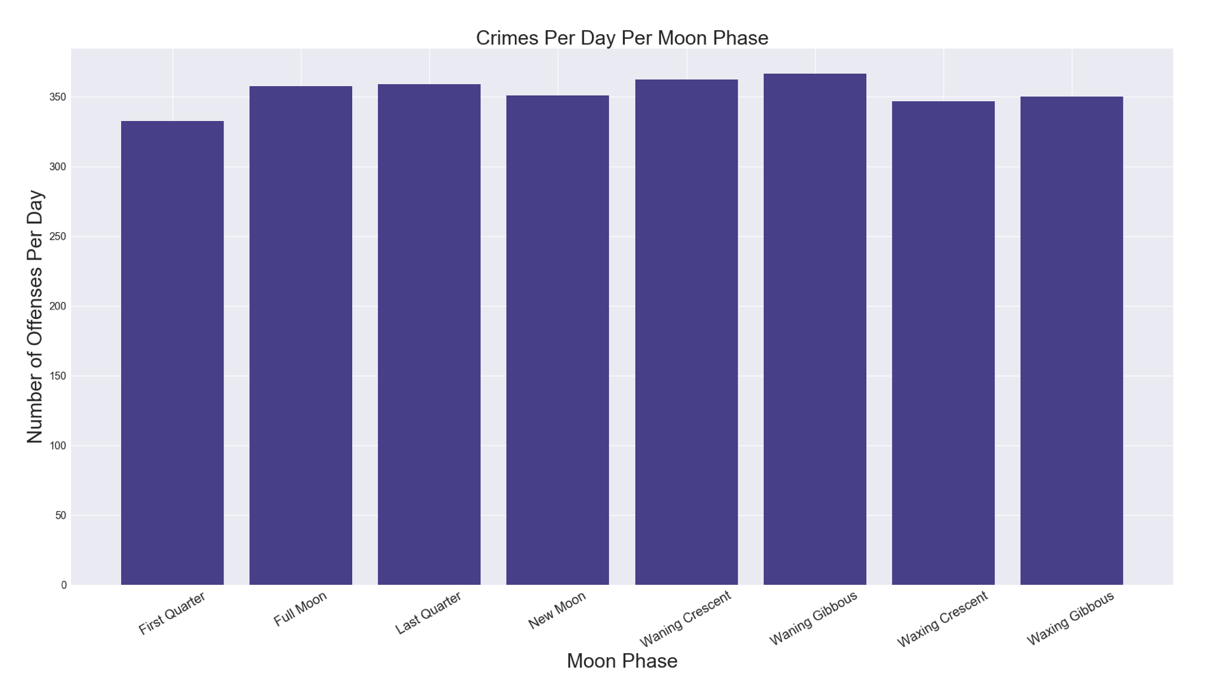

Slide 11
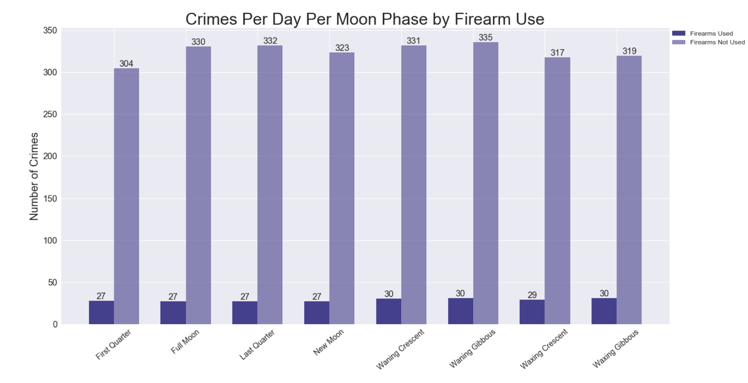

Slide 12
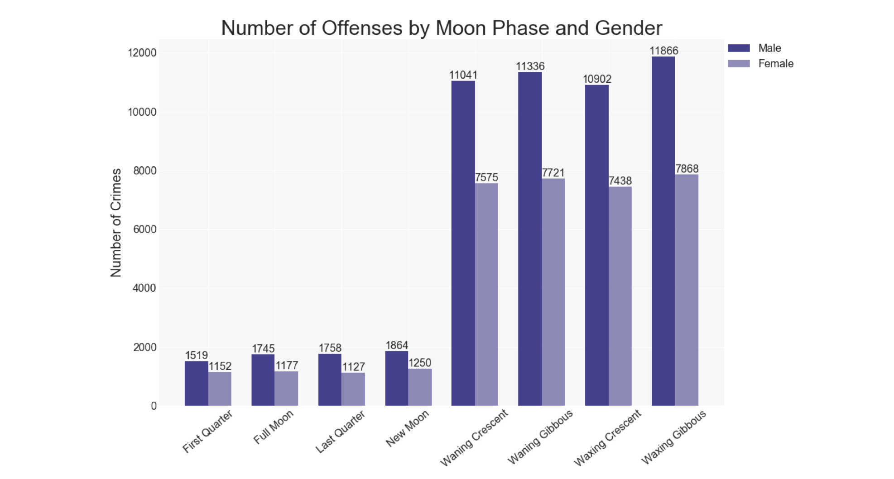

Slide 13
Discussion
Findings:
Based on our findings we were unable to prove our hypothesis that more crimes are committed on days in which there is a full moon.
Conclusion:
A full moon does not cause people to commit more crimes nor do other specific phases of the moon
Notes:
Discuss your findings. Did you find what you expected to find? If not, why not? What inferences or general conclusions can you draw from your analysis?

Slide 14
Post Mortem
Difficulties:
Only having one year of data to analyze and therefore only 12 full moons to analyze
Having to rework script within the notebooks to get the data to do what we wanted it to
Additional Questions:
Are the results we found similar to other cities?
Would we find the same results if we analyzed 5 years of data?
If you analyze the date of birth of current inmates in KCMO jails, is there a trend with being born within a specific moon phase?
Notes:
Discuss any difficulties that arose, and how you dealt with them
Discuss any additional questions that came up, but which you didn't have time to answer: What would you research next, if you had two more weeks?

Slide 15
Questions
Notes:
Open the floor for Q&A

Slide 16
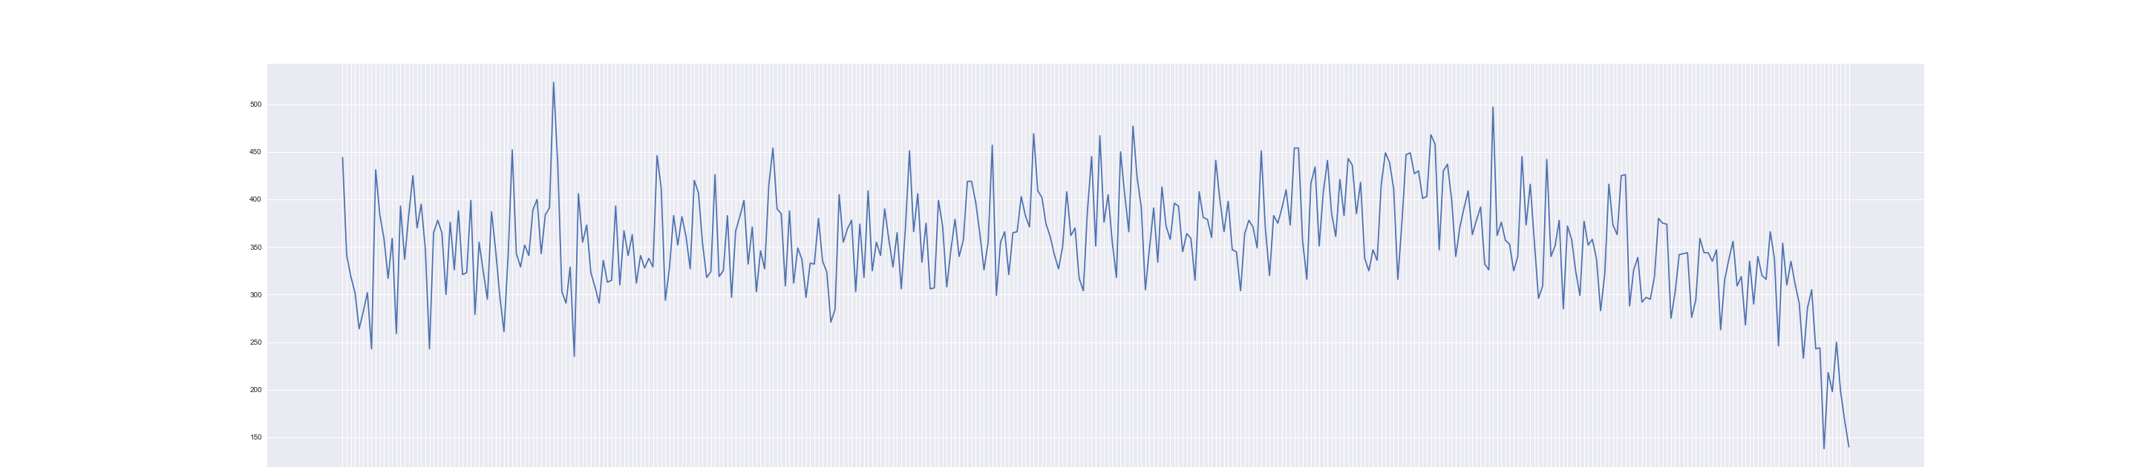
Number of Offenses Committed Each Day in 2017
Number of Offenses Committed
Days
Notes:
Number of crimes vs days

Slide 17
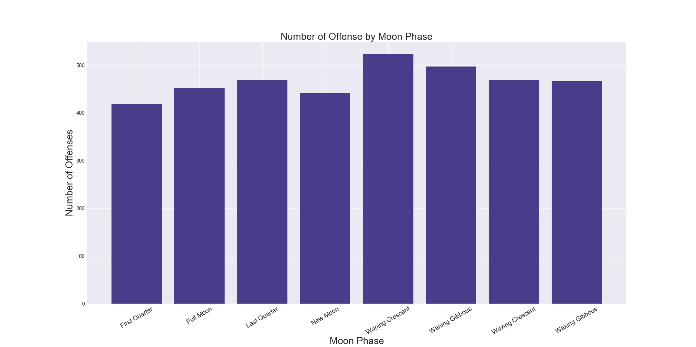

Slide 18
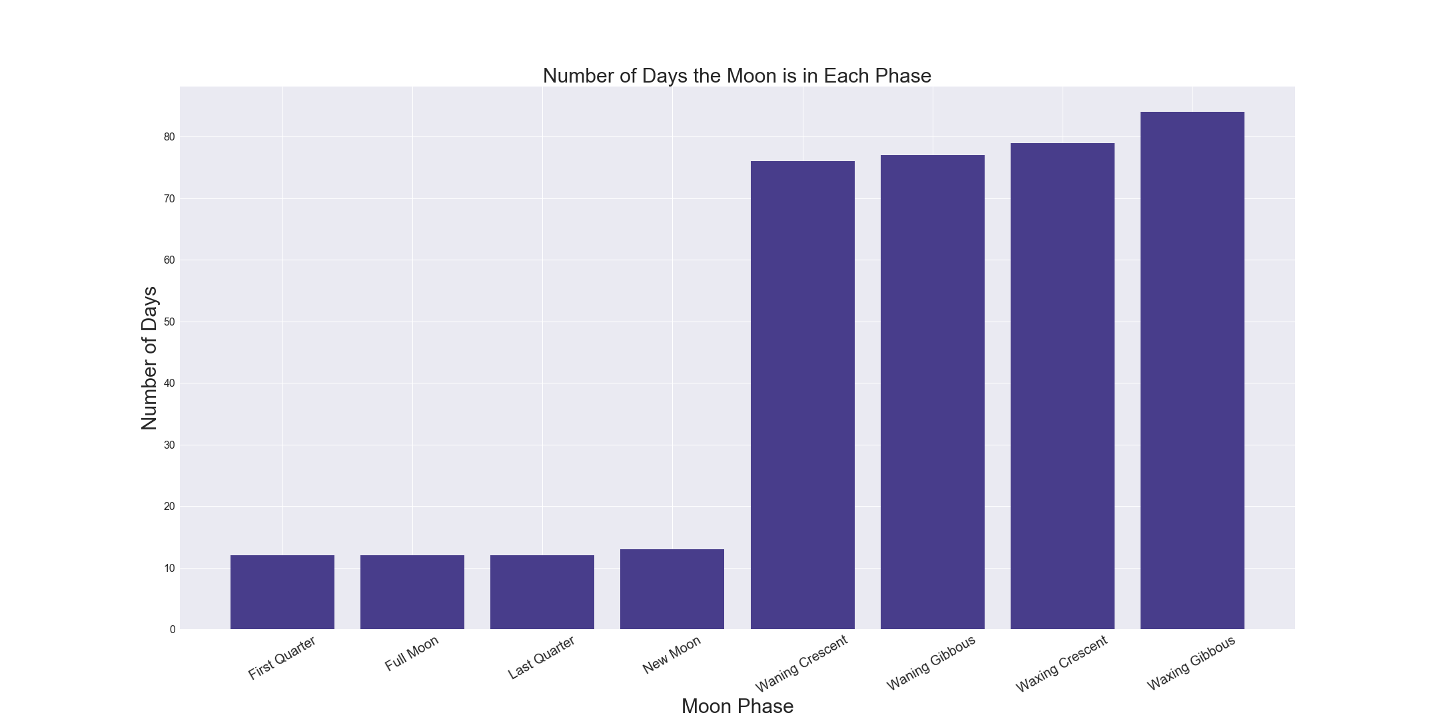
Notes:
Crime every 4 minutes

Slide 19
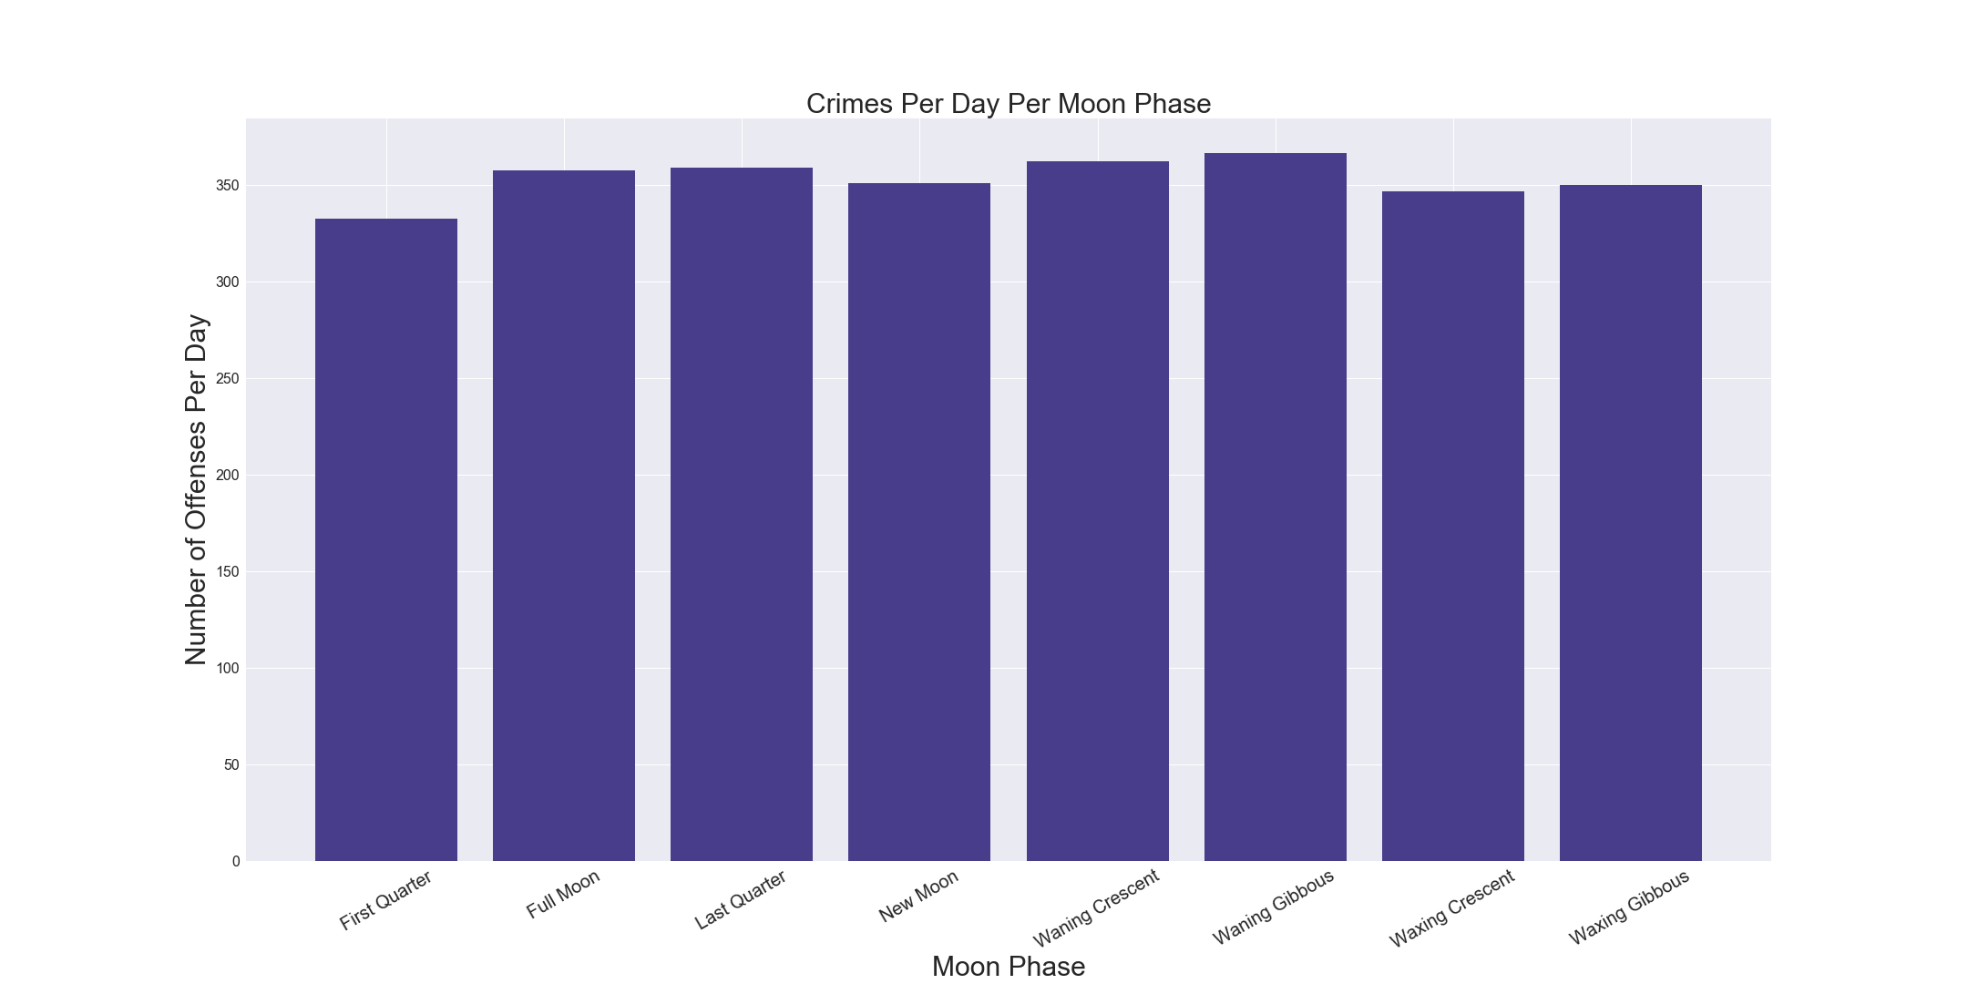
Notes:
Number of crimes vs days

Slide 20
Notes:
Number of crimes vs days

Slide 21
Notes:
Number of crimes vs days

